Slide 1


Slide 2
Building ASP.NET 6 Application with Azure

Slide 3
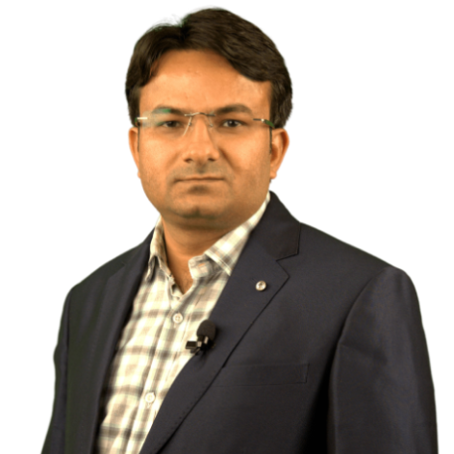

About Me
Founder & CEO at ScholarHat & DotNetTricks
Seven Times Microsoft MVP (2016-2022)
Technical Consultant & Corporate Trainer
Microsoft Certified Azure Professional
Trained 25000+ Students Live Across the World
Author of 14 eBooks on Interview Q&A
Author of 425+ Articles
Author of 120+ Video Based Courses
Shailendra Chauhan
@proshailendra

Slide 4
Agenda
Choosing Microsoft Azure Services
Top 10 Azure Services Every Developer Must Know
ASP.NET 6 Application (ePizzaHub) Architecture
Dive into Code
ASP.NET and Azure Application Architecture
Application Demo: ePizzaHub
Q&A

Slide 5
Choosing Microsoft Azure Services

Slide 6

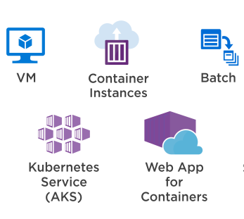
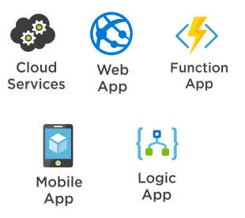
Application Hosting Options
Infrastructure-as-a-service(IaaS)
Platform-as-a-service(PaaS)
#AzConfDev

Slide 7
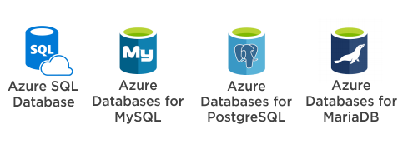

Data Storage Options
Structured Data - RDBMS
Unstructured Data - NoSQL/Docs
#AzConfDev

Slide 8

Analytics Options
#AzConfDev

Slide 9



Messaging Options
Service Bus
Event Grid
Event Hubs
#AzConfDev

Slide 10


Application Security Options
#AzConfDev

Slide 11
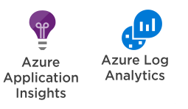
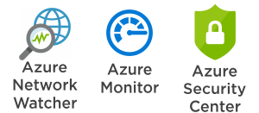
Monitoring Options
Monitoring: Application Level
Monitoring: Subscription Level
#AzConfDev

Slide 12

10 Azure Services Every Developer Must Know!
Azure Service Bus
#AzConfDev

Slide 13
Building ASP.NET 6 Application (ePizzaHub)

Slide 14
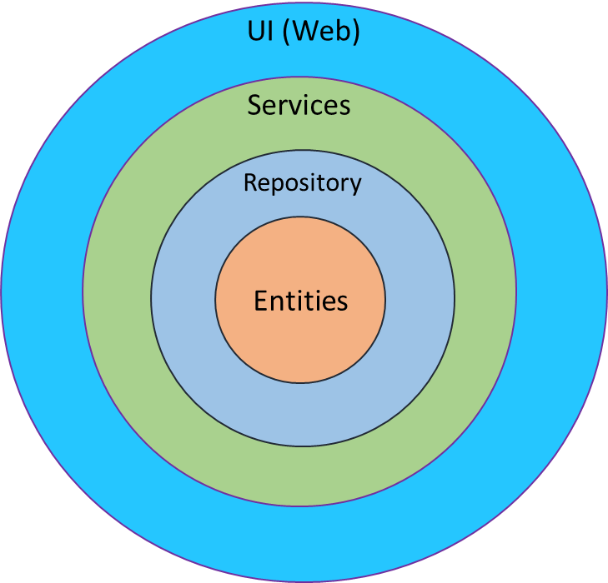
ASP.NET6 Application (ePizzaHub) Architecture
Web UI
Services (Business)
DB
DAL (Repository)
Entities (Core)
#AzConfDev
Notes:
.NET and .NET Core official support policy (microsoft.com)

Slide 15
Dive into Code

Slide 16



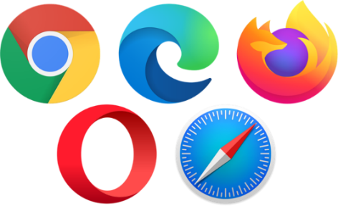








ASP.NET6 and Azure Application Architecture -1
Redis Cache
Web App
Azure SQL
Database
Insight
Queue
Function App
Bob Storage
Vault
Azure AD
#AzConfDev

Slide 17


ASP.NET6 and Azure Application Architecture -2
Redis Cache
VM
Azure SQL
Database
Cosmos DB
Insight
Queue
Function App
Bob Storage
Vault
Azure AD
#AzConfDev

Slide 18
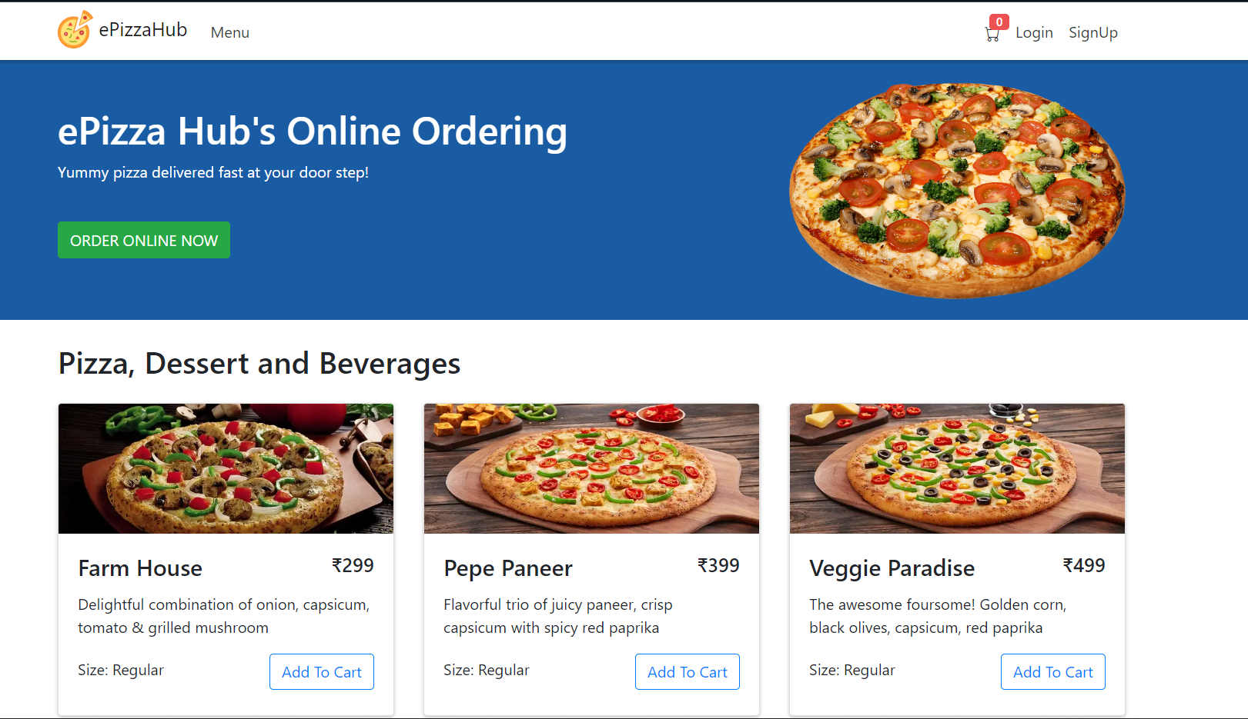
DEMO
www.epizzahub.azurewebsites.net
Code: https://github.com/proshailendra/azconf-22

Slide 19






Platinum Partner
Gold Partner
Silver Partner

Slide 20
Q&A

